Slide 1

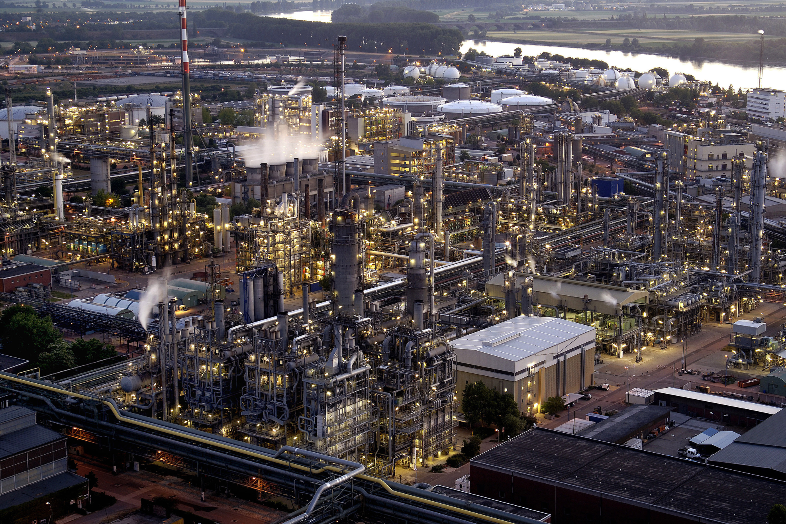
Augsburg University of Applied Sciences | Faculty of Mechanical and Process Engineering
Brno University of Technology | Faculty of Mechanical Engineering |
Institute of Process and Environmental Engineering
Projektování a řízení procesů (KPJ)
Conceptual Design of Distillation, Absorption
and Stripping Systems
Prof. Dr.-Ing. Marcus Reppich
Room D5/249
 marcus.reppich@hs-augsburg.de
Important notice: These documents are to be used exclusively for study purposes, they are made available to participants of the lecture Conceptual Design of Distillation, Absorption and Stripping Systems (Projektování a řízení procesů, KPJ) at the Institute of Process and Environmental Engineering at the Brno University of Tech-nology only.
Cover image: Copyright by BASF SE

Slide 2
Conceptual Design of Distillation, Absorption and Stripping Systems
Timetable and Contents of Lectures and Exercises
Lectures
19.11.2013 | P 09 | Fundamentals of Binary Distillation
26.11.2013 | P 10 | Types of Distillation Columns
03.12.2013 | P 11 | Design of Distillation Columns
Exercises
19.11.2013 |  | Assignment date
26.11.2013 | C 10 | Design of a Multicomponent Distillation System Using the Process Simulation Software CHEMCAD (group work of two students, elaboration of a final project report)
03.12.2013 | C 11
10.12.2013 | C 12
13.12.2013 |  | Due date

Slide 3
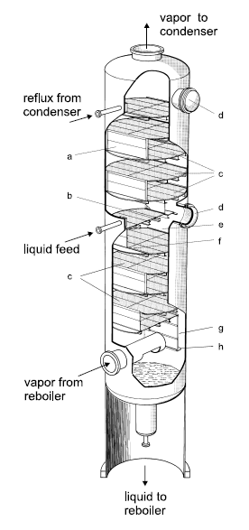
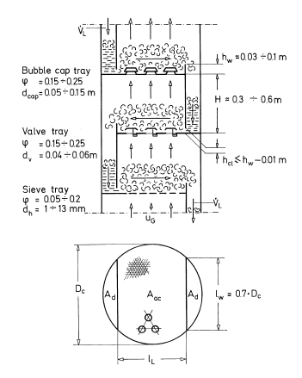
2 Types of Distillation Columns
Tray Column Design
Symbols
a | downcomer
b | tray support
c | sieve trays
d | man way
e | outlet weir
f | inlet weir
g | side wall of downcomer
h | liquid seal
A_{ac} | active area
A_{d} | downcomer area
D_{c} | column diameter
d_{cap, v, h} | bubble cup, valve, hole diameter
H, Δz | tray spacing
h_{cl} | height of down-comer clearance
h_{w} | weir height
l_{w} | weir length
l_{L} | length of liquid flow path
ϕ | relative free area
Characteristic dimensions
of industrial tray designs
w_{G}
Source: A. Mersmann, M. Kind, J. Stichlmair: Thermal
Separation Technology. Berlin, Heidelberg: Springer 2011

Slide 4
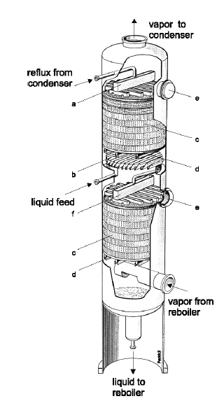
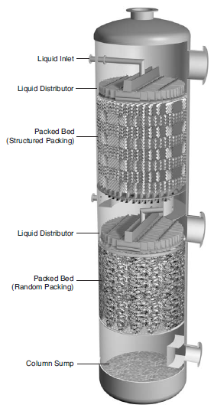
2 Types of Distillation Columns
Design Principles of Packed Columns: Tower with Structured Packing (A); Tower with Structured-Packed Top Bed and Random-Packed Bottom Bed (B)
(A)
Symbols
a | liquid distributor
b | liquid collector
c | structured packing
d | support grid
e | man way
f | liquid re-distributor
(B)
Sources: A. Mersmann, M. Kind, J. Stichlmair: Thermal Separation Technology. Berlin, Heidelberg: Springer 2011; D.W. Green (ed.): Perry´s Chemical Engineers´ Handbook, New York: McGraw-Hill 2008

Slide 5
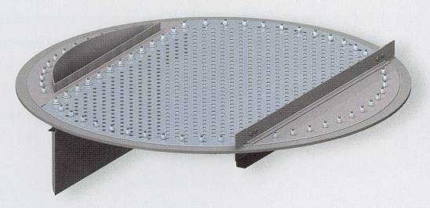
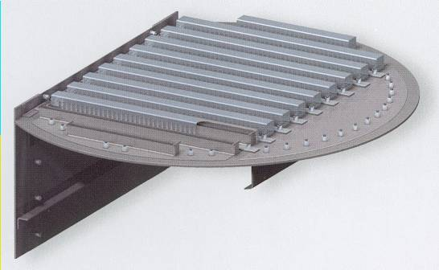
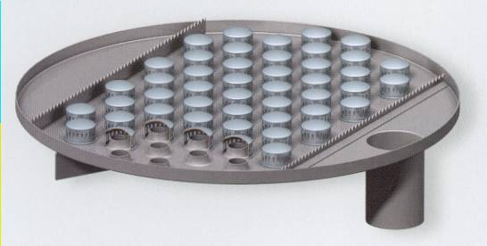
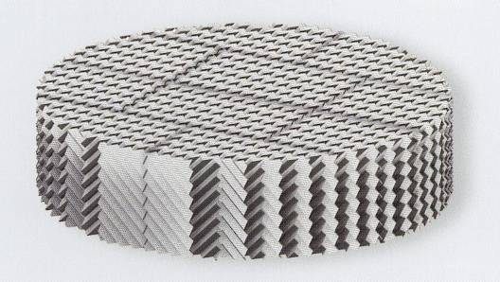
2 Types of Distillation Columns
Examples of Distillation Column Internals
Sieve Tray
Tunnel Cap Tray
Bubble Cap Tray
Struktured Packing
Source: GEA Wiegand GmbH, Ettlingen

Slide 6
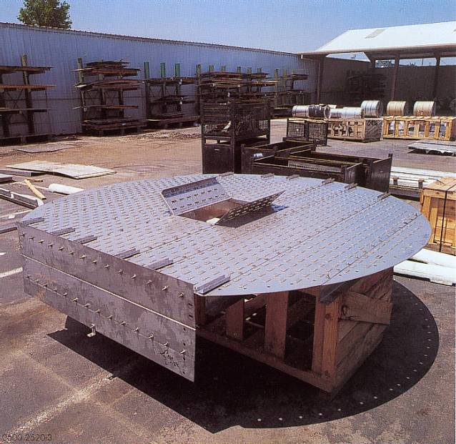
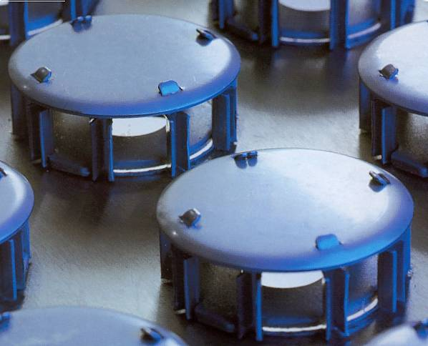
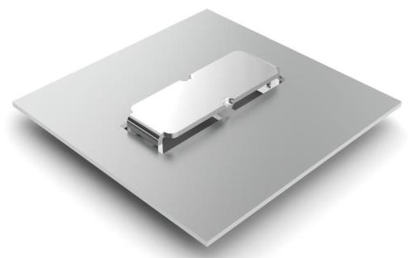
2 Types of Distillation Columns
Examples of Distillation Column Internals
Detail of Varioflex™ valve tray
Source: Koch-Glitsch, Inc.
Floating valve tray with rectangular-shaped valves
(BDH™ valve)
Source: Sulzer Chemtech AG

Slide 7
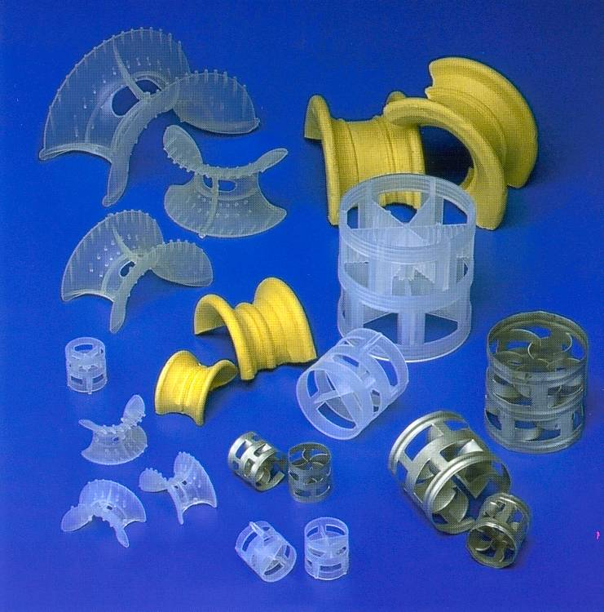
2 Types of Distillation Columns
Examples of Distillation Column Internals
Common Random Packings
Common random packing particles
made of metal, plastic, ceramic
Sorce: Koch-Glitsch, Inc.

Slide 8
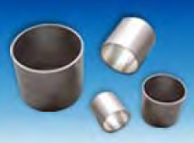
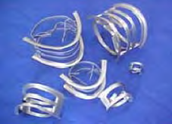
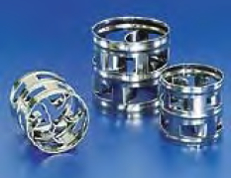
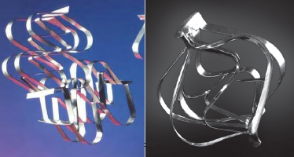
2 Types of Distillation Columns
Examples of Distillation Column Internals
Historical Development of Characteristic Random Packings
First Generation (Raschig Ring, Berl Saddle)
1895 to the 1950s
simple shapes with closed surfaces, robust
and stable design, cost-effective production
Third Generation (Net/Grid Structures, IMPT Ring)
late 1970s to the 1990s
framework structure, large free cross section,
low pressure drop, high efficiency
Second Generation (Pall Ring, Intalox Saddle)
late 1950s to the early 1970s
surfaces with cutted windows and bent tongues,
improved area distribution lowering pressure
drop and enhancing capacity
Fourth Generation (Raschig Super-Ring)
late 1990s until present
lower pressure drop and better mass transfer
efficiency

Slide 9
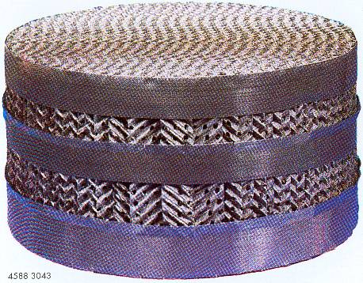
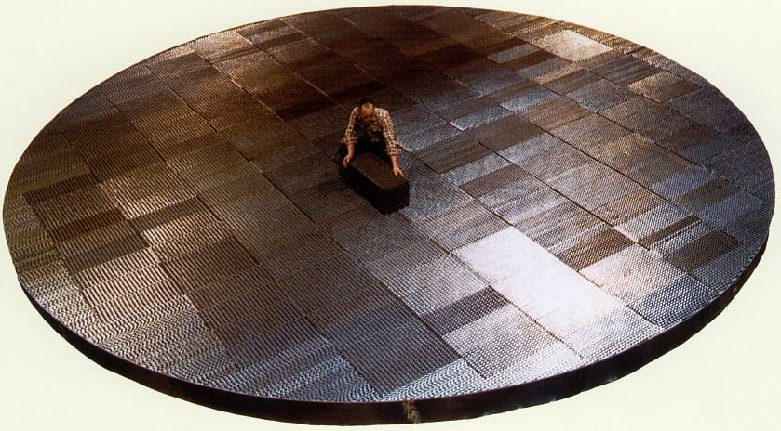
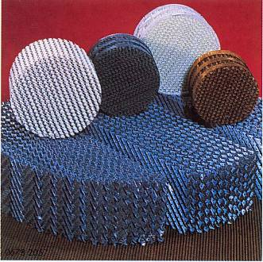
2 Types of Distillation Columns
Examples of Distillation Column Internals
Common Types of Structured Packings
Structured packing of corrugated metal sheets
Fitting structured packing elements Flexipac™ to a large-diameter tower
Structured packings Mellapak™
made of metal and plastic
Sources: Sulzer Chemtech AG; Koch-Glitsch, Inc.

Slide 10
2 Types of Distillation Columns
Comparsion of Tray and Packed Columns
Tray Columns |  | Packed Columns
 | cross flow of the two phases on the trays |  | countercurrent flow of the two phases
 | always used in columns of large diameters and towers that have more than 20 to 30 equilibrium stages, in applications with liquid rates of 30 m³/(m²h) and above, when liquid flowrate is high relative to vapor flowrate |  | packings are generally more expensive than plates, less expensive than tray columns for small column diameter (D<0.6 m), used in lower liquid-rate-applications (i.e. less than 50 m³/(m² h)
 | various tray types made of metallic materials (D=500–10000 mm) |  | more choices in materials of construction especially in corrosive service (e.g. plastic, ceramic, metal alloys, carbon), random (D=50–800 mm) or structured packings (D=20–11000 mm)
 | high liquid residence time |  | less liquid entrainment, low liquid holdup, especially suitable for thermally sensitive material
 | pressure drop is rather high, typically 7 mbar per equilibrium stage (not well suited for vacuum services) |  | lower pressure drop, typically 0,1 to 0,5 mbar per equilibrium stage (important in vacuum distillation)
 | dirty service (tray columns are easier to clean) |  | cleaning of a packing section is much too complica-ted and expensive
 | stable and robust operation of the separation process, more flexible to variations in operating conditions |  | foaming liquids can be handled more readily (less agitation of liquid by the vapour)
 |  |  | due to novel developments of packing elements the industrial use of packed columns is steadily increasing

Slide 11
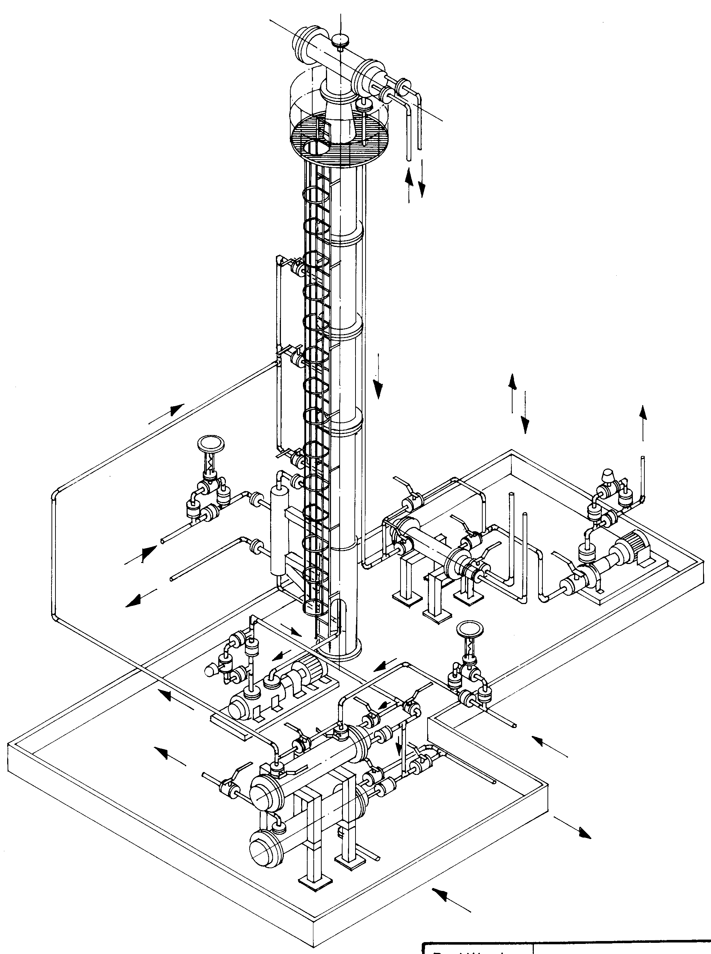
2 Types of Distillation Columns
Overall View of a Distillation Unit
Condenser
Cooling Water
Distillate
Cooling Water
Feed
Distillate
Distillate
Cooler
Distillate
Pump
Steam
Reboiler
Pump
Feed
Feed Preheater
Bottom Product
Bottom Product
Cooler
Cooling Water
Source: GVWU mbH, Norderstedt

Slide 12
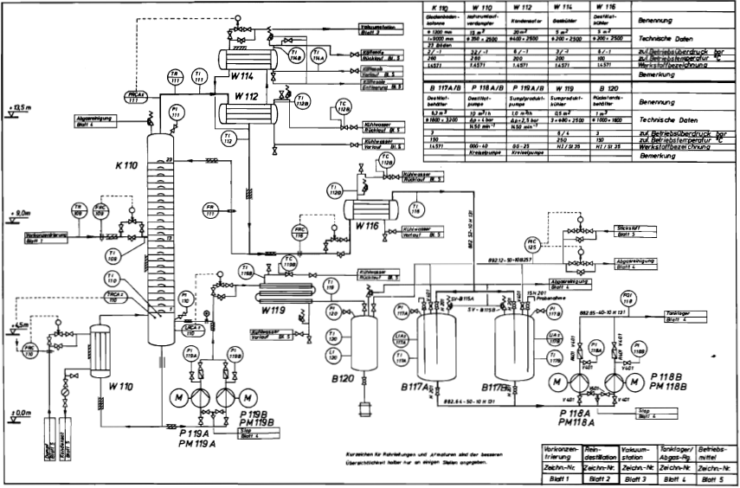
2 Types of Distillation Columns
Piping and Instrumentation Diagramm of a Distillation Unit
Source: Baerns, M. et al.: Technische Chemie. Weinheim: WILEY-VCH 2006

